Slide 1
Qubit Mapping Inspired by Graph Theory
Sanjiang Li
April 4, 2023

Slide 2
Graph ideas
Subgraph Isomorphism
Divide and Conquer
Token Swapping
Graph symmetry and mappings
Permutation graph theory
Dynamic graph or time graph

Slide 3
Introduction
Permutation graph theory focuses on understanding the relationship between graph properties and node permutations. In particular, researchers in this field study how the structure of a graph changes when its nodes are permuted in different ways, and how these changes affect various graph invariants such as connectivity, chromatic number, and degree distribution.

Slide 4

Introduction
Just like driving through a mountain road to the peak, you should adjust the car’s position from time to time to get to the peak safely.
Given an architecture/host graph H, a logic circuit C, which may be regarded as a guest graph ship, we want to find a sequence of permutations of H, written as H₀, H₁, ..., H_{m} s.t. the logic circuit can be embedded in the sequence in the following sense:
partition C into subcircuits C₀, C₁, ..., C_{m}
The interaction graph G_{i} of subcircuit C_{i} is a subgraph of H_{i}
The permutation from H_{i} to H_{i+1} has a cost c_{i} and the sum of these costs is minimal

Slide 5
Graph Properties
What kind of properties may be useful? The dynamic embedding problem depends on the properties of the circuit (graph) and the architecture.
Given a circuit, we first profile it in terms of the necessary properties
Implement a subgraph isomorphism algorithm, e.g., VF2

Slide 6
Topic one
Given a batch of small circuits, map them in a large architecture so that they can be run in parallel.

Slide 7
k-Partitioning Problem
Given an architecture graph G, we aim to partition G into k parts s.t. each part can host one task circuit in a given batch.
Sunil Chopra and M. R. Rao. 1993. The partition problem. Math. Program. 59, 1–3 (March 1993), 87–115. https://doi.org/10.1007/BF01581239

Slide 8
Optimal substructure
On Optimal Subarchitectures for Quantum Circuit Mapping
Tom Peham, Lukas Burgholzer, Robert Wille, arXiv: 2210.09321

Slide 9
Topic Two
Given a small circuit, select a proper subgraph from an architecture s.t. it can be executed on the subgraph without inserting too much SWAPs when compared with mapping it on AG directly.

Slide 10
Topic Three
Suppose we can use extra qubits in the architecture, which could be ancilla qubits. Can we find better transformations with lower depth?

Slide 11
SABRE with extra qubits
In SABRE search, let f: Q → V be the current mapping and F the current front layer. The swap candidates are edges (u,u’) s.t. u or u’ is in Img(f). Apparently, it is possible that u or u’ may be not in Img(f).
So this has already covered in SABRE. We can include MOVE gates.

Slide 12
Topic Four
How to measure the difference between two AGs? e.g., Sycamore vs. Rochester? In this case, Rochester is embeddable in Sycamore, but can we design a metric to show how many average SWAPs are required to transform a Sycamore circuit to a Rochester circuit?

Slide 13
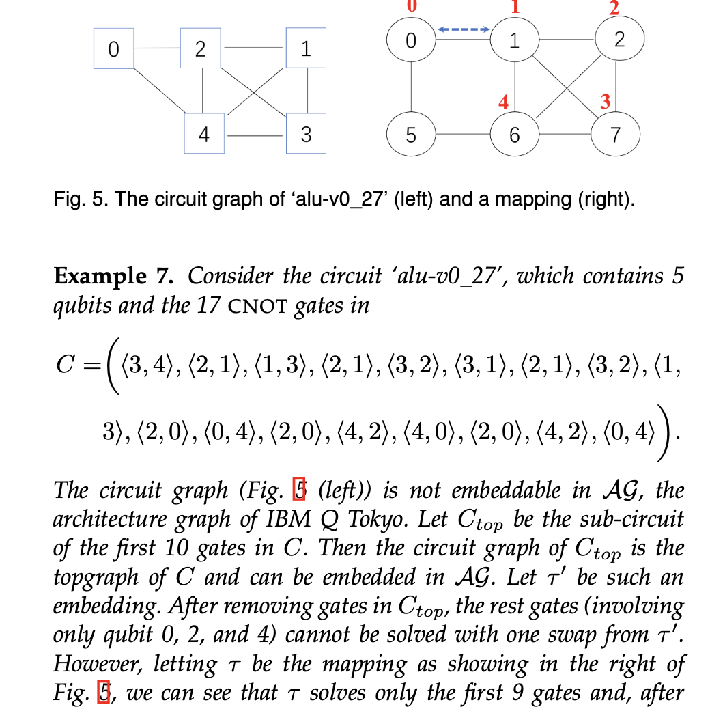
Greedy is not the best for subgraph isomorphism

Slide 14
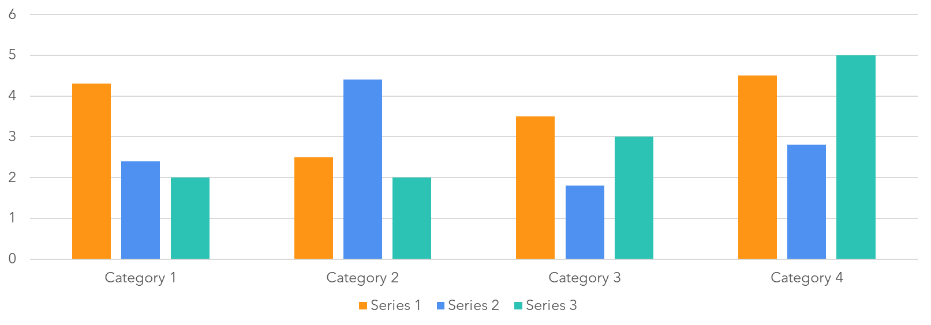
Chart

Slide 15
Table
 | Category 1 | Category 2 | Category 3 | Category 4
Item 1 | 4.5 | 2.3 | 1.7 | 5
Item 2 | 3.2 | 5.1 | 4.4 | 3
Item 3 | 2.1 | 1.7 | 2.5 | 2.8
Item 4 | 4.5 | 2.2 | 1.7 | 7

Slide 16
The way to get started is to quit talking and begin doing.
Walt Disney

Slide 17
Team
Name Title
Name Title
Name Title
Name Title

Slide 18
Timeline
To start a presentation, go to the Slide Show tab, and select From Beginning.
1
To display Presenter view, in Slide Show view, on the control bar at the bottom left select the three dots, and then Show Presenter View.
2
During your presentation, the speaker notes are visible on your monitor, but aren't visible to the audience.
3
The Notes pane is a box that appears below each slide. Tap it to add notes.
4
If you don’t see the Notes pane or it is completely minimised, click Notes on the task bar across the bottom of the PowerPoint window.
5

Slide 19
Content
Subtitle
Subtitle
Add text, images, art, and videos.
Add transitions, animations, and motion.
Save to OneDrive, to get to your presentations from your computer, tablet, or phone.
Open the Design Ideas pane for instant slide makeovers.
When we have design ideas, we’ll show them to you right there.

Slide 20
Content
Subtitle
Subtitle
Subtitle
Add text, images, art, and videos.
Add transitions, animations, and motion.
Save to OneDrive, to get to your presentations from your computer, tablet, or phone.
Open the Design Ideas pane for instant slide makeovers.
When we have design ideas, we’ll show them to you right there.
This PowerPoint theme uses its own unique set of colours, fonts, and effects to create the overall look and feel of these slides.
PowerPoint has tons of themes to give your presentation just the right personality.

Slide 21

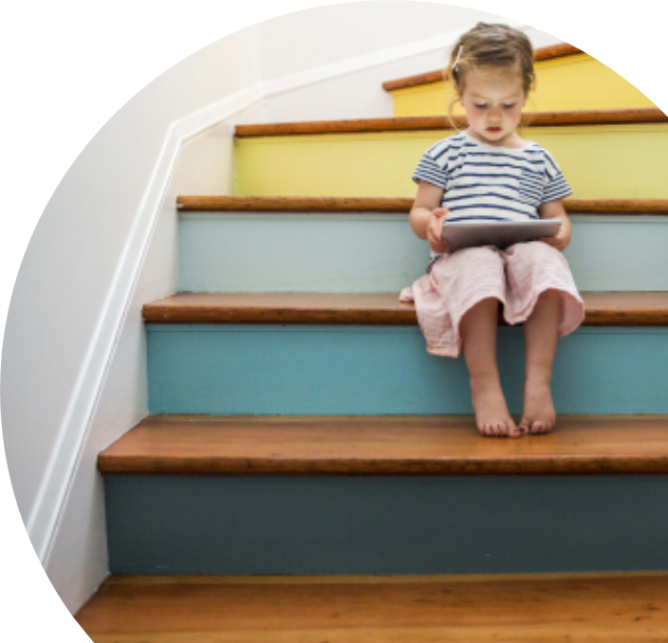
Summary
With PowerPoint, you can create presentations and share your work with others, wherever they are. Type the text you want here to get started. You can also add images, art, and videos on this template. Save to OneDrive and access your presentations from your computer, tablet, or phone.

Slide 22
Thank you
Presenter name
Email address
Website

Slide 23
References
Permutation Groups and Combinatorial Structures by Biggs, Norman.; White, Arthur T.
1979

Slide 25
How to select a best sub-AG?
A topic for our next paper
September 24, 2020
Sanjiang Li

Slide 26
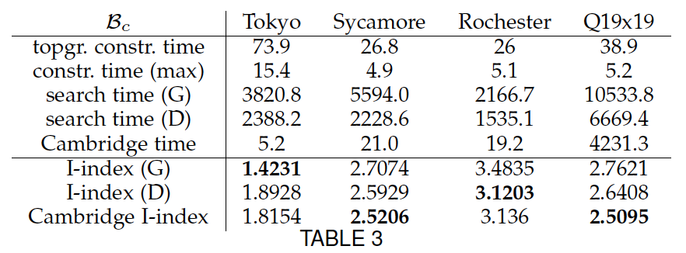
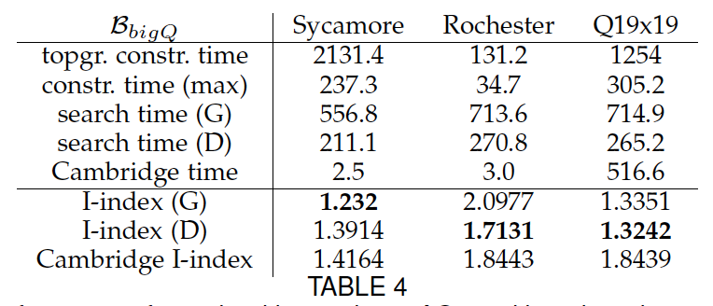
Motivation
In our TC paper, we compared performances of FiDLS and Cambridge on Tokyo, Rochester, Sycamore and Q19x19
Cambridge becomes 200x to 800x slower on Q19x19, while the quality is not significantly better or even much worse than that on Sycamore
The results of FiDLS in Tables 3&4 are not the same as our current implementation, but still, in both tables, we can see that the results are not improved when comparing Q19x19 and Sycamore.
Very likely, the random method of Gushu Li does not apply well in large AG (check!)
Sycamore is embeddable in Q19x19
Notes:
https://quantumcomputing.stackexchange.com/questions/8552/why-does-googles-quantum-processor-outperform-ibms
https://www.ibm.com/blogs/research/2019/03/power-quantum-device/

Slide 27
How to compare two AGs?
Given AG1 and AG2 with the same number of qubits, when can we say AG1 is better than AG2?
If AG2 is embeddable in AG1, then yes!
If not so, there is a circuit executable on AG2 but not on AG1: consider the circuit consisting a CNOT<p,q> for each edge (p,q) in AG2.

Slide 28
Relevant parameters
Number of edges
Diameter
Degrees
Circle
For each parameter, design an experiment to compare different values by using randomly generated circuits

Slide 29
Compare subgraphs of the same AG
For each circuit, find the best subgraph of the AG and carry out the QCT based on this subgraph
Consider the special AG Rochester, which is less regular than Sycamore and Q19x19
e.g., for any circuit with up to 10 qubits, it is not necessary to go outside rochhalf? To prove this, we need to show at least that any 10-node subgraph is embeddable in rochhalf.
The shortest path btw any two nodes is within the subgraph?

Slide 30
Reading list
Childs et al. 2019 on qct ✅
Circuit transformations for quantum architectures
The idea is given the pre. map β, the current circuit L1, construct a new map α s.t. the somehow defined value, e.g., rt(G, α*β⁻¹) of α is minimal.
Siraichi et al. on subgraph isomorphism ✅
Qubit allocation as a combination of subgraph isomorphism and token swapping
The implementation is based on bounded brute-force search and compare of all embeddings and thus the result is not better than ours

Slide 31
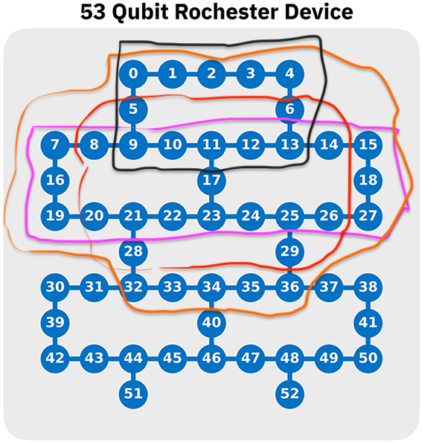
Consider the subgraph with nodes in [7,27], called rochhalf. Is any subgraph with less than 22 nodes embeddable in this subgraph?
No! The subgraph on {5,6,8-14, 17} has 10 nodes and 3 nodes with deg 3!
For roch19b, which has no cycle, the results are not much worse!

Slide 32
To do list
Consider depth?
Combine topgraph and token swapping? How about wgtgraph?
Generate better topgraph considering rhat value?
Design an RL-game-like platform for QCT?
Towards more effective QCT algorithms for Rochester?

